Slide 1

How should we program non-volatile memory?
Dhruva Chakrabarti, Haris Volos, Indrajit Roy
Hewlett Packard Labs

Slide 2
Housekeeping

Slide 3



Who we are
Dhruva Chakrabarti
Haris Volos
Indrajit Roy

Slide 4
Tutorial outline
Module 1:
  Introduction to persistent memory
  Prior work on persistent programming model
Module 2:
  Persistency models and hardware characteristics
Module 3:
  Programming models for persistent memory: Mnemosysne, NV-Heaps, Atlas
  Ongoing work on persistent memory
  Q/A and brainstorming
Tutorial time: 9am -12pm
Break from 10:00 -10:30 am

Slide 5
Our goal is to foster a discussion around persistent memory…
… ask questions, give suggestions, and let’s brainstorm on interesting ideas !

Slide 6
From volatile to persistent memory

Slide 7
Tape is Dead
Disk is Tape
Flash is Disk
RAM Locality is King
Jim Gray, Microsoft, December 2006

Slide 8

Cheap DRAM = emergence of in-memory systems
256GB of DRAM is common, and 1-2TB DRAM is affordable!
Applications have moved from disk optimized to completely in-memory system
  Memcached : Facebook stores 25% of all data in DRAM (RAMCloud 2009)
  SAP HANA: in-memory database on TBs of RAM
  Spark: In-memory processing for with query latency in seconds
But persistent storage is still needed for durability and availability
HPE DL580 servers
Upto 3TB of DRAM

Slide 9
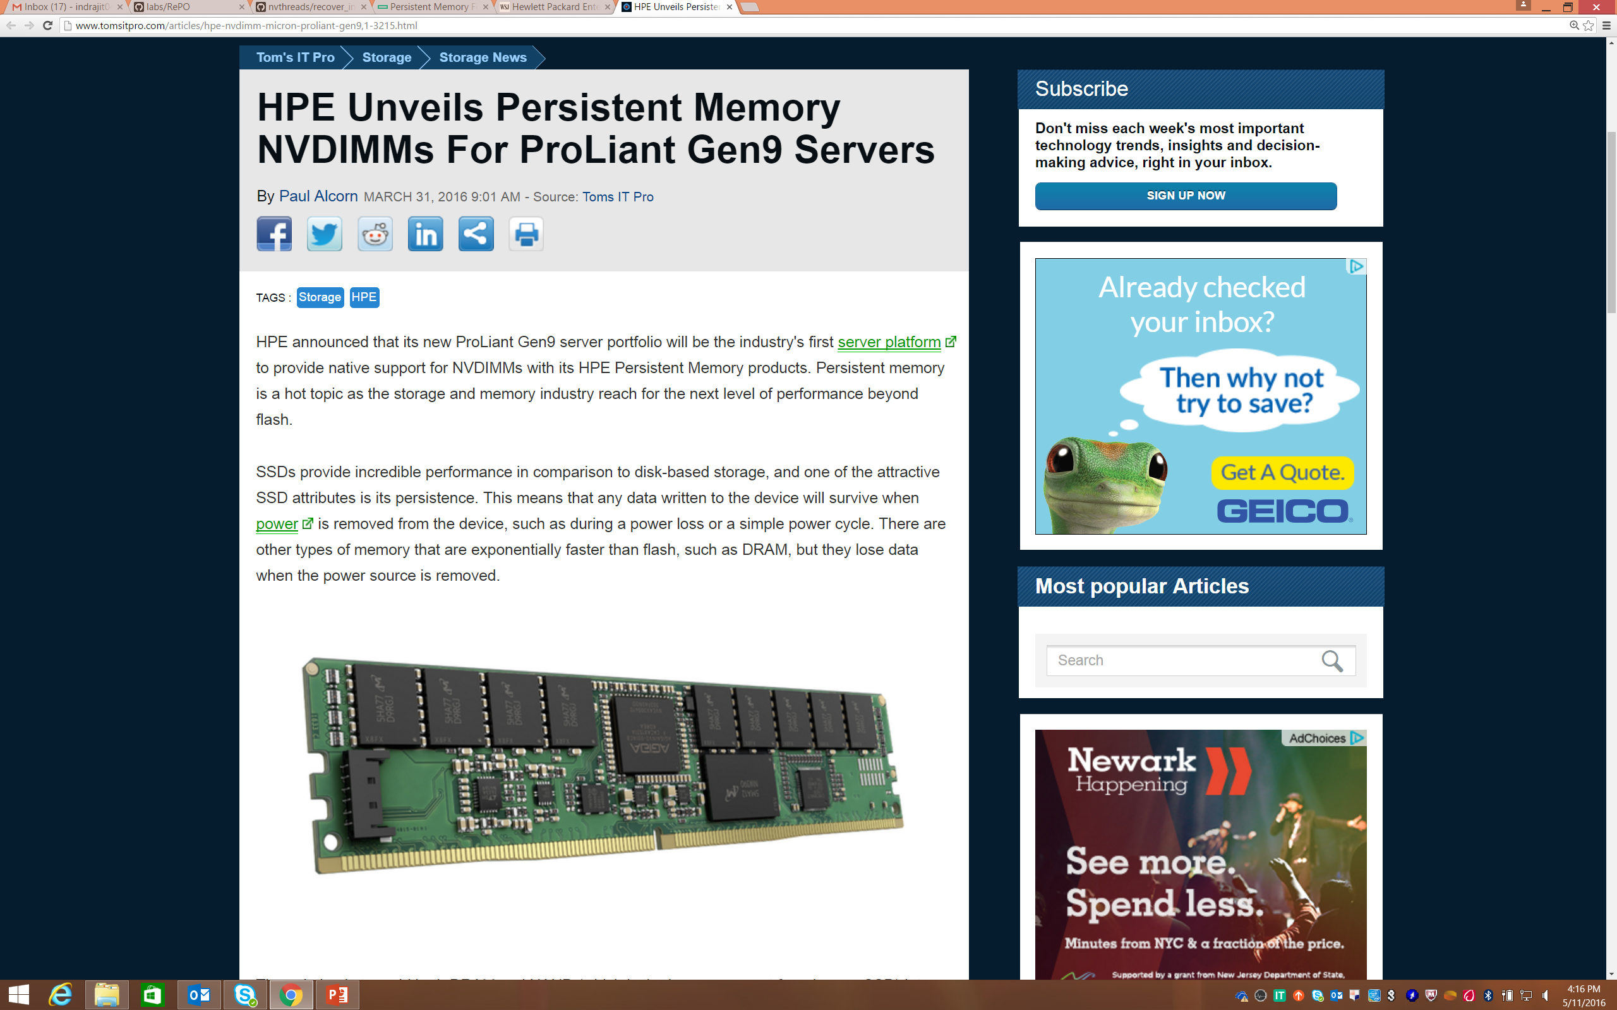
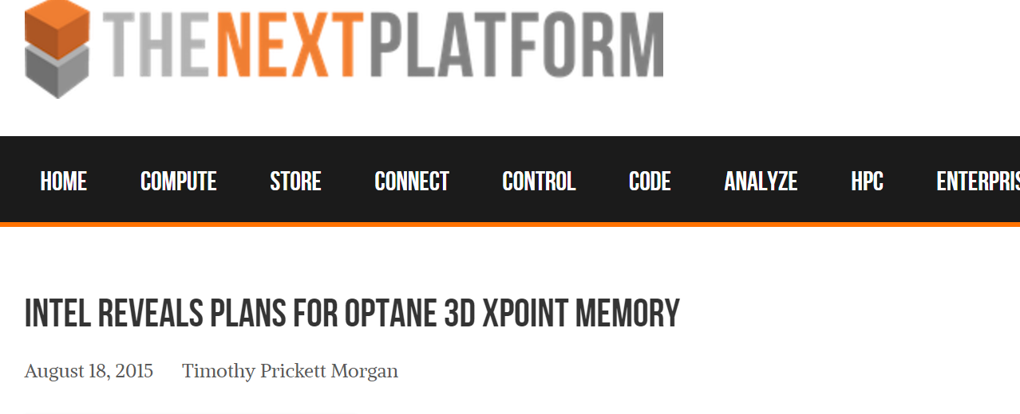
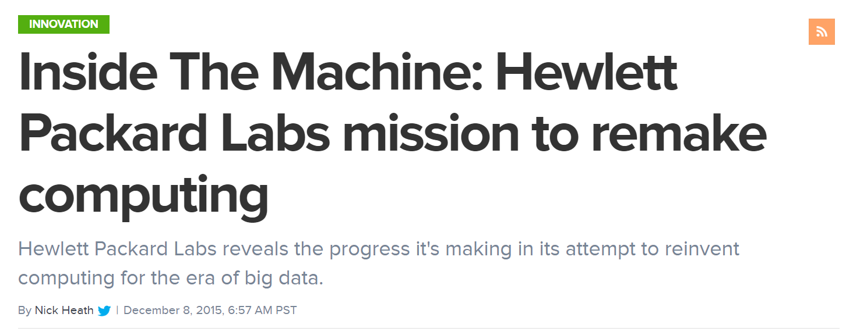
Non-volatile memory is here

Slide 10
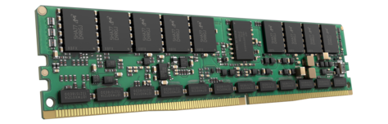
Benefits of non-volatile memory
Three key features of non-volatile memory (NVM):
Persistence = data retention even after power off
low latency = read/write in < 100ns (DRAM like)
byte addressability = use load/store instructions
Why should we care?

Slide 11
Use case 1: Making filesystems faster
  NVM devices are 10x-100x faster than flash → faster filesystem operations by just using NVM
  Filesystems can be made NVM-aware for further improvements. E.g., ext4-with-DAX
    Page cache is used to buffer read and writes
    In the presence of NVM, remove page cache and write directly to NVM devices. Reduces extra copies.
- Research file systems: Intel PMFS [Eurosys 2014], Microsoft BPFS [SOSP 2009]

Slide 12
Use case 2: Improving performance of databases
  Databases have high overheads to maintain consistency in the presence of failures
    Transaction implementation require logging and concurrency control mechanisms
  In the presence of NVM, transaction commit protocols can leverage byte addressable persistence
    Variety of new approaches: in-place updates with logging, copy-on-write updates with no logging, etc. [Arulraj et. al. Sigmod’15]
  NVM can improve database performance by more than 5x in some cases

Slide 13
Use case 3: Persistence for everyone
  Object level persistence
    Single format of data
    Load/store access
    No translation layer
    Possibly part of programming languages
  A new class of applications with persistence as a first class citizen, not an after-thought

Slide 14
Tutorial outline
Module 1:
  Introduction to persistent memory
  Prior work on persistent programming model
Module 2:
  Persistency models and hardware characteristics
Module 3:
  Programming models for persistent memory: Mnemosysne, NV-Heaps, Atlas
  Ongoing work on persistent memory
  Q/A and brainstorming
Tutorial time: 9am -12pm
Break from 10:00 -10:30 am

Slide 15
Overall abstraction: Object-level persistence
Persistent Region
Root
Outside data is considered transient

Slide 16
Programming principles: Orthogonal Persistence
(Atkinson et al., SIGMOD Record ‘96)
  Persistence independence
    Transient and persistent data are manipulated uniformly
  Data type orthogonality
    Persistence should not depend on the type of data
  Persistence by reachability
    All data reachable from a persistent root are persistent

Slide 17
An Example: PJava
    Any object transitively reachable from the persistent map is made persistent
    Small amount of additional code required
    Compiler and standard libraries are unchanged
    Book bk1 = new Book(3); //transient allocation
    Book bk2 = new Book(8);
    PJavaStore library = PJavaStore.getStore(); //root location of the persistent region
    library.newPRoot(“Book_main”, bk1); //make allocated book persistent

Slide 18
The E persistent programming language
(Richardson et al., TOPLAS ‘93)
  Extension of C++
  Supports transparent persistence
  Database type (or db type) introduced
  Persistent storage class introduced
  Persistence by allocation, not reachability
  Example:
  persistent dbint total_count = 0;

Slide 19
Summary of past research
  Orthogonal persistence was a major consideration
  Object oriented databases: a number of flavors were tried
  Some flavors of transactional support provided
  The underlying storage technology (hard disk) was abstracted away
  Performance was an issue since no real persistent memory was available
Should we re-think persistent programming principles for the new hardware?

Slide 20
What are some primary challenges?
Common programming idiom:
tmp = nvm_malloc() // allocate a persistent location
init(tmp) // initialize the allocated location
persistent_ptr = tmp // publish it, assigning a persistent pointer to the location

Slide 21
Consistency management
Due to compiler/hardware reordering:
tmp = nvm_malloc() // allocate a persistent location
persistent_ptr = tmp // publish it, assigning a persistent pointer to the location
init(tmp) // initialize the allocated location

Slide 22
Need for Ordering Constraints
A failure may lead to a dangling persistent pointer:
tmp = nvm_malloc() // allocate a persistent location
persistent_ptr = tmp // publish it, assigning a persistent pointer to the location
Crash

Slide 23
Required Ordering Constraints
Requires initialization to be ordered before publication:
tmp = nvm_malloc() // allocate a persistent location
init(tmp) // initialize the allocated location
persistent_ptr = tmp // publish it, assigning a persistent pointer to the location

Slide 24
Tutorial outline
Module 1:
  Introduction to persistent memory
  Prior work on persistent programming model
Module 2:
  Persistency models and hardware characteristics
Module 3:
  Programming models for persistent memory: Mnemosysne, NV-Heaps, Atlas
  Ongoing work on persistent memory
  Q/A and brainstorming
Tutorial time: 9am -12pm
Break from 10:00 -10:30 am

Slide 25
Persistency models and hardware characteristics

Slide 26


Persistent Memory
CPU
load/store
Caches
Memory Bus
DRAM
NVRAM
Challenges
  Fail-stop fault model
  Only data in NVRAM survives
  Transient data does not survive

Slide 27
Consistent updates through ordering
struct Payload {
bool valid;
u64 data[2];
};
1: STORE data[0] = 0xFOOD
2: STORE data[1] = 0xBEEF
3: STORE valid = 1

Slide 28
Write-back caching reorders writes to NVM
  Improves performance
  But breaks correctness
STORE data[0] = 0xFOOD
STORE data[1] = 0xBEEF
STORE valid = 1
CPU
V
D
D
Write-back Cache
NVM
D
D
V
CPU
Crash

Slide 29
Write-back caching reorders writes to NVM
  Improves performance
  But breaks correctness
STORE data[0] = 0xFOOD
STORE data[1] = 0xBEEF
STORE valid = 1
CPU
V
D
D
Write-back Cache
NVM
GARBAGE
D
D
V
1
CPU
Crash
Reordering breaks recovery
Recovery incorrectly considers garbage as valid data

Slide 30
Simple solutions
Disable caching
Write-through caching
Flush entire cache at commit

Slide 31
Persistent Memory ordering
1: PERSIST data[0]
2: PERSIST data[1]
3: PERSIST valid
Program order
implies unnecessary
constraints
1
2
3

Slide 32
Persistent Memory ordering
1: PERSIST data[0]
2: PERSIST data[1]
3: PERSIST valid
Program order
implies unnecessary
constraints
1
2
3
  Need interface to describe necessary constraints
Notes:
Mention how clflush today implements strict persistency based on program order.

Slide 33
Persistent Memory ordering
1: PERSIST data[0]
2: PERSIST data[1]
3: PERSIST valid
1
Need interface to
expose necessary
constraints
3
2
  Expose persist concurrency; sounds like consistency!
Notes:
Clflushopt/epoch to relax strict persistency based on program order.

Slide 34
Persistency Models: Memory consistency for NVM
[Pelley, ISCA 2014]
Memory consistency models
  Constrain order of loads and stores between CPUs
Memory persistency models
  Constrain order of writes with respect to failure

Slide 35
Persistency models and ordering hardware
Existing
  Strict program order
Proposals
  Intel x86 ISA extensions [Intel14]
  BPFS epochs barriers [Condit, SOSP09]
  Strand persistency [Pelley, ISCA14]
Relax persistency to
expose persist parallelism

Slide 36
Ordering with existing hardware
Order writes by flushing cachelines via CLFLUSH
But, CLFLUSH:
  Stalls the CPU pipeline and serializes execution
STORE data[0] = 0xFOOD
STORE data[1] = 0xBEEF
CLFLUSH data[0]
CLFLUSH data[1]
STORE valid = 1
data[0]
ST
CLFLUSH
data[1]
ST
CLFLUSH
stall (~200ns)
valid
ST
time

Slide 37
Ordering with existing hardware
Order writes by flushing cachelines via CLFLUSH
But, CLFLUSH:
  Stalls the CPU pipeline and serializes execution
  Invalidates the cacheline
  Only sends data to the memory subsystem – does not commit data to NVM
STORE data[0] = 0xFOOD
STORE data[1] = 0xBEEF
CLFLUSH data[0]
CLFLUSH data[1]
STORE valid = 1

Slide 38
Fixing CLFLUSH: Intel x86 extensions
CLFLUSHOPT
CLWB
PCOMMIT

Slide 39
CLFLUSHOPT
Provides unordered version of CLFLUSH
Supports efficient cache flushing
STORE data[0] = 0xFOOD
STORE data[1] = 0xBEEF
CLFLUSHOPT data[0]
CLFLUSHOPT data[1]
SFENCE // explicit ordering point
STORE valid = 1
Implicit
orderings

Slide 40
CLFLUSHOPT
Provides unordered version of CLFLUSH
Supports efficient cache flushing
data[0]
ST
CLFLUSH
data[1]
ST
CLFLUSH
valid
ST
time
data[0]
ST
CLFLUSHOPT
data[1]
ST
CLFLUSHOPT
valid
ST
time

Slide 41
CLWB
Write backs modified data of a cacheline
Does not invalidate the line from the cache
  Marks the line as non-modified
Note: Following examples use CLWB

Slide 42
PCOMMIT
Commits data writes queued in the memory subsystem to NVM
STORE data[0] = 0xFOOD
STORE data[1] = 0xBEEF
CLWB data[0]
CLWB data[1]
SFENCE // orders subsequent PCOMMIT
PCOMMIT // commits data[0], data[1]
SFENCE // orders subsequent stores
STORE valid = 1
PCOMMITs execute serially

Slide 43
Example: Copy on write
R
Z
X
Y

Slide 44
Example: Copy on write
R
R’
update(Y)
Z
Z’
STORE Y’
STORE Z’
CLWB Y’
CLWB Z’
PCOMMIT
STORE R’
CLWB R’
X
Y
Y’

Slide 45
Example: Copy on write
R
R’
R’’
update(Y)
update(X)
Z
Z’
Z’’
STORE Y’
STORE Z’
CLWB Y’
CLWB Z’
PCOMMIT
STORE R’
CLWB R’
PCOMMIT
STORE X’
STORE Z’’
CLWB X’
CLWB Z’’
PCOMMIT
STORE R’
CLWB R’
X
Y
Y’
X’

Slide 46
Example: Copy on write
Y’
ST
CLWB
PCOMMIT
Z’
ST
CLWB
R’
stall
ST
CLWB
PCOMMIT
X’
stall
ST
CLWB
PCOMMIT
Z’’
ST
CLWB
stall
R’’
ST
CLWB
PCOMMITs execute serially
time

Slide 47
BPFS Epoch barriers
Barriers separate execution into epochs: sequence of writes to NVM from the same thread
Writes within same epoch are unordered
Epoch
STORE …
STORE …
EPOCH_BARRIER
STORE …
EPOCH_BARRIER
STORE …
Epoch
Epoch
A younger write is issued to NVM only after all previous epochs commit

Slide 48
Example: Copy on write
R
R’
update(Y)
STORE Y’
STORE Z’
EPOCH_BARRIER
STORE R’
Z
Z’
Epoch
X
Y
Y’
Epoch

Slide 49
Example: Copy on write -- Failure
R
R’
STORE Y’
STORE Z’
EPOCH_BARRIER
STORE R’
WRITEBACK X’
WRITEBACK Y’
WRITEBACK R’
Z
Z’
Y
Y’
L1/L2
R
Y
Y’
X
X’
NVM

Slide 50
Example: Copy on write
R
R’
R’’
update(Y)
update(X)
Z
Z’
Z’’
STORE Y’
STORE Z’
EPOCH_BARRIER
STORE R’
EPOCH_BARRIER
STORE X’
STORE Z’’
EPOCH_BARRIER
STORE R’
X
Y
Y’
X’

Slide 51
PCOMMIT/CLWB VS Epochs barriers
Commits happen synchronously
Y’
ST
CLWB
PCOMMIT
Z’
ST
CLWB
R’
stall
ST
CLWB
PCOMMIT
X’
ST
CLWB
time
X’
ST
WRITEBACK
Commits happen asynchronously
Z’
ST
WRITEBACK
R’
ST
WRITEBACK
X’
ST
WRITEBACK
time

Slide 52
Summary
Ordering primitive | Persists | Commits
CLFLUSH | Serial | N/A
PCOMMIT/CLWB | Parallel | Synchronous
Epochs | Parallel | Asynchronous

Slide 53
Tutorial outline
Module 1:
  Introduction to persistent memory
  Prior work on persistent programming model
Module 2:
  Persistency models and hardware characteristics
Module 3:
  Programming models for persistent memory: Mnemosysne, NV-Heaps, Atlas
  Ongoing work on persistent memory
  Q/A and brainstorming
Tutorial time: 9am -12pm
Break from 10:00 -10:30 am

Slide 54
Persistent programming models
Mnemosyne and NV-Heaps

Slide 55
Traditional approach to durability
Separate object and persistent formats
Translation code
Programmability and performance issues
In-memory objects
File or
Database
Serialize
Deserialize
Notes:
Transition from file systems to persistent heaps

Slide 56
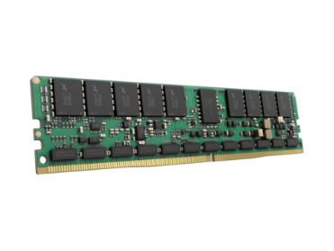
User Persistent Memory
Challenge: consistency
App
App
System call interface
Load/store
Memory Bus

Slide 57

Mnemosyne in a nutshell:
Persistent Regions + Consistency
[Volos et el, ASPLOS 2011]
Persistent address-space regions survive restart
  Fine-grain and low-latency access
  Flexible usage

Slide 58


Persistent Regions
Address Space
QUEUE
DRAM
NVM

Slide 59
Persistent Regions
Address Space
QUEUE
DRAM
NVM

Slide 60
Mnemosyne in a nutshell:
Persistent Regions + Consistency
[Volos et el, ASPLOS 2011]
Persistent address-space regions survive restart
  Fine-grain and low-latency access
  Flexible usage
Consistency mechanisms
  Safe updates in the presence of failures
  Ordered writes: flush/fence

Slide 61
Durable memory transactions
A
B
C
patomic {
B.next = C;
C.prev = B;
}

Slide 62
Durable memory transactions
A
B
C
C.val = X;
patomic {
B.next = C;
C.prev = B;
}
Completion of patomic does NOT guarantee persistence of C.val

Slide 63
Implementing durable memory transactions
Intel STM Compiler instruments atomic blocks
libmtm runtime supports ACID transactions via redo-based write-ahead logging
patomic {
B.next = C;
C.prev = B;
}
begin_transaction();
stm_store(&B.next, C);
stm_store(&C.prev, B);
commit_transaction();

Slide 64
Undo vs Redo Logging
Write old data durably to log before in-place update
Write new data durably to log before in-place update
Log
ST
CLFLUSH
ST
CLFLUSH
ST
CLFLUSH
Data
ST
ST
CLFLUSH
time
Log
ST
ST
ST
CLFLUSH
Data
ST
CLFLUSH
time
Notes:
If set of writes unknown (e.g. on-going transaction), may have multiple flushes before update. If know all stores at once, then cost is simillar

Slide 65
Persistent Heap
Enables allocating blocks of memory within a persistent region
Requires programmer ensure reachability to avoid space leakage
  API helps programmer:
  pmalloc(sz, addr) atomically sets pointer to newly allocated memory
myNamedRoot
myObj
pstatic void * myNamedRoot;
pmalloc(…, &myNamedRoot);
pmalloc(…, &(myObj->child));

Slide 66
NV-Heaps: Smart pointers for referential integrity
[Colburn, ASPLOS’11]
Prevent persistent memory leaks
  Pointers maintain per-object reference count
  Objects have to be reachable from the heap’s root
Prevent unsafe references
  NO non-volatile pointers to volatile data
  NO inter-heap pointers
Support NV-Heaps relocation
  Hold offset rather than absolute address

Slide 67

Hash table example
pstatic htRoot = NULL;
htRoot
0x00000AAA
0000000000
Static
main() {
if (!htRoot)
pmalloc(N*sizeof(*bucket), &htRoot);
}
update_hash(key, value) {
patomic {
pmalloc(sizeof(*bucket), &bucket));
bucket->key = key;
bucket->value = value;
insert(hash, bucket);
}
}
Persistent Heap
key
value

Slide 68
Performance Evaluation
NVM performance model based on DRAM
Configurations
Platform: Intel Core 2 2.5GHz (4 cores)
FLUSH (addr)
CLFLUSH (addr)
MODEL_DELAY_NS (150)
NVM-disk
Mnemosyne
Application
Application
Virtual File System
Persistent Memory
Ext2 File System
Block Layer
RAM-disk + delay

Slide 69
Applications
TokyoCabinet: Key-value store
  Original: msyncs B-tree to a mmap’d file
  Modified: keeps B-tree in persistent memory
OpenLDAP: Directory service
  Original: stores dir-entries in Berkeley DB
  Modified: keeps dir-entries in persistent memory

Slide 70
Application performance
30,361
14.8x
Update throughput
relative
to NVM-disk
35%
2,044
5,428
7,350
Write-mostly workloads
TokyoCabinet: 1024-byte ins/del queries
OpenLDAP: template-based update queries

Slide 71
Persistent programming models
Atlas

Slide 72
Programming model and principles
Persist and reuse (instant restart)
One format of data
Fine grained updates: directly byte-addressed with CPU loads and stores
Preserve existing programming models as much as possible

Slide 73
Eliminating failure-induced inconsistencies
Support for failure-atomic updates
  transfer(int from, int to, double amount) {
  __durable {
  accounts[from] -= amount;
  accounts[to] += amount;
  }
  }

Slide 74
Use model
Persistent Region API
Consistency API
User Program
Compile
Instrumented User Program
Runtime library
Execute
Recover
Persistent Data

Slide 75
Persistent Region API
Basic program structure
pr = find_or_create_persistent_region(name);
persistent_data = get_root_pointer(pr);
if (persistent_data is absent) {
// initialize persistent_data
p_addr = pmalloc(pr, size);
set_root_pointer(pr, p_addr);
}
else {
use_persistent_data()
}
Persistent Region
Root
Outside data is considered transient

Slide 76
Consistency API
lock/unlock
  Outermost critical sections are failure-atomic (FASE)
  Transparent compatibility with existing threaded software
durable {}
  Durable sections (no isolation)

Slide 77
A multithreaded persistent queue using Atlas
tail
val1
val2
n1
n2
pr = find_or_create_persistent_heap(“queue”);
q = get_root(pr);
if (q is absent) initialize q and call set_root(pr, q)
Thread 1
Thread 2
enqueue(val) {
pmalloc()
init_node()
L.lock()
attach_node()
move_tail()
L.unlock()
}
dequeue() {
L.lock()
elem = read_head()
move_head()
L.unlock()
return elem
}
Consistent section

Slide 78
Current implementation
Compiler support built on top of LLVM
Library support for C/C++ environment on single node
First-class persistence support for lock-based programs
Compiler/runtime generate cache line flush/invalidate
Persistent logs automatically written at runtime
If there is a failure, recovery initiated automatically before program restart
Code available at https://github.com/HewlettPackard/Atlas

Slide 79
Notion of a Failure-Atomic SEction (FASE) (OOPSLA 2014)
T2
T1
Time
: FASE
: Inner critical sections
    Unlocked program points are thread-consistent
    Outermost critical sections are failure-atomic

Slide 80
Property 1
If an update within a FASE is durable, all persistent updates within it are also durable

Slide 81
Other properties
FASEs may have to be persisted in order
Handling updates outside FASEs

Slide 82
Persistent Undo Log Structure
Start
T1
X,1
T2
X,0
Y,0
Transient hash table
Time
T1
X = 2
X = Y = Z = 0
T2
X = 1
Y = X
Thread operations

Slide 83
Computing a Consistent State
Start
T1
X,1
T2
X,0
Y,0
Transient hash table
Time
T1
X = 2
X = Y = Z = 0
T2
X = 1
Y = X
Thread operations

Slide 84
Computing a Consistent State
Start
C1
T1
X,1
T2
X,0
Y,0
Transient hash table
Time
T1
X = 2
X = Y = Z = 0
T2
X = 1
Y = X
Thread operations

Slide 85
Advancing the Consistent State
Start
T1
X,1
C2
T2
X,0
Y,0
Transient hash table
Time
T1
X = 2
X = Y = Z = 0
T2
X = 1
Y = X
Thread operations

Slide 86
Pruning the Log Structure
Start
T1
X,1
C2
T2
Y,0
Transient hash table
Time
T1
X = 2
X = Y = Z = 0
T2
X = 1
Y = X
Thread operations

Slide 87
Recovery after a crash
Start
T1
X,1
T2
Y,0

Slide 88
Speeding up existing durable applications: MDB
    Originally: disk-based key-value store
    Atlas-based:
      Files replaced with persistent regions
      Critical sections => no change

Slide 89

Adding durability to a transient Memcached
    Originally: transient distributed key-value cache
    Opportunity: instant restart from NVRAM
    Atlas-based (durable and consistent cache):
      Hash table and helpers placed in a persistent region
      Critical sections => no change
+60%
+20%

Slide 90
Tutorial outline
Module 1:
  Introduction to persistent memory
  Prior work on persistent programming model
Module 2:
  Persistency models and hardware characteristics
Module 3:
  Programming models for persistent memory: Mnemosysne, NV-Heaps, Atlas
  Ongoing work on persistent memory
  Q/A and brainstorming
Tutorial time: 9am -12pm
Break from 10:00 -10:30 am

Slide 91
Ongoing work
NVthreads

Slide 92
NVthreads : Implementing Atlas like semantics
[Hsu et. al. NVMW’16]
  Pthreads = standard multi-threading library for C/C++ programs
  NVthreads = drop-in replacement for the pthreads library
  Existing C/C++ programs become crash tolerant when linked to NVthreads
  Advantages:
  Minimum porting effort, supports lock based programs
  Good performance
  $ gcc app.c –o app.out –rdynamic libnvthread.so –ldl

Slide 93
Key ideas
Use synchronization points to infer failure atomic sections (HPE Atlas [OOPSLA’14]).
  Does not require applications to use transactions
Execute multi-threaded program as multi-process program (DThreads [SOSP’11]).
  Process memory buffers uncommitted writes
Track data modifications at page granularity.
  Amortizes logging overhead vs fine-grained tracking

Slide 94
Today’s applications
C/C++ Application
User
space
pthreads
Thread creation and management
Kernel space
Operating System
Memory allocation and file system interface for DRAM
DRAM
Volatile main memory
e.g., stacks
Hardware

Slide 95
Using NVthreads
C/C++ Application
User
space
Kernel space
Operating System
Memory allocation and file system interface for DRAM and NVM
DRAM
Volatile main memory
e.g., stacks
NVM
Persistent regions
e.g., linked list on heap
Hardware

Slide 96
Using NVthreads
C/C++ Application
User
space
Modifications
Allocate data in NVM: nvmalloc()
Recover data in NVM: nvrecover()
Add recovery code, persistent allocations
NVthreads library
Multi-process, intercepting synchronization, tracking data, maintaining log
Link to NVthreads library
Kernel space
Operating System
Memory allocation and file system interface for DRAM and NVM
DRAM
Volatile main memory
e.g., stacks
NVM
Persistent regions
e.g., linked list on heap
Hardware

Slide 97
Implementing atomic durability
Convert threads to processes
    Use copy-on-write and process memory to buffer updates. No undo log
Track dirty pages, and merge with global state at synchronization points
  After crash, recover using redo log
1 : # Transfer money
2 : pthread_lock(&m);
3 : Alice = Alice - $10;
4 : Walmart = Walmart + $10;
5: pthread_unlock(&m)
Process
Process
Process
Process
Threads

Slide 98
From threads to processes
Track dirty pages
NVM
log
write
Merge
shared state
Wait
P1
Start
Stop
Pass
lock
Wait
Track dirty pages
NVM
log
write
Merge
shared state
P2
Start
Stop
Parallel
phase
Parallel
phase
Critical section
Execute
Wait

Slide 99
Setup
Machine
Ubuntu 14.04 (Linux 3.16.7), two Intel Xeon X5650 processors (12cores@2.67GHz), 198GB RAM and 600GB SSD
  Applications
  PARSEC benchmarks, Phoenix benchmarks, PageRank, and K-means
  NVM emulator
  Linux tmpfs on DRAM
  Injects 1,000ns delay to each 4KB page write via RDTSCP instruction

Slide 100
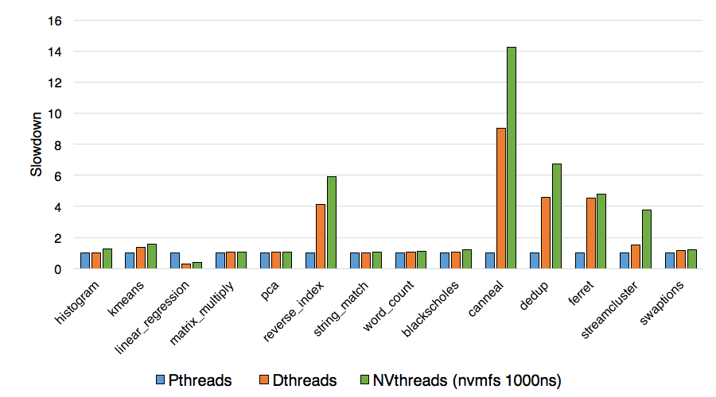
Performance vs pthreads
9 out of 14 applications: NVthreads incurs less than 20% overhead vs pthreads
Remaining 5 applications: 4x to 14x slowdown vs pthreads

Slide 101
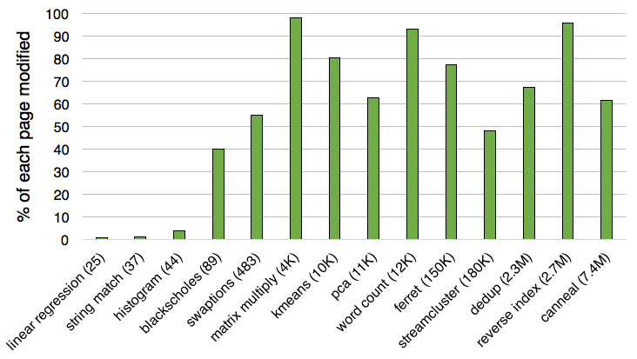
Is coarse grained tracking a good fit?
9 out of 14 applications touch more than 55% of each page
It is worthwhile to track data at page granularity in these apps!
Notes:
Make sure we say enough to justify why this experiment is important

Slide 102
Ongoing work
Managed data structures

Slide 103
Managed Data Structures (MDS)
Simplify programming on persistent in-memory data
Ease of Programming
  Programmer manages only application-level data structures
  APIs in multiple programming languages: Java, C++
    Programmer access through references to data
    Direct reads and writes
Ease of Data Sharing
  Just pass a reference
  High-level concurrency controls
    Ensure consistent data in the face of data sharing by multiple threads/processes
Managed Space
Process 1
Process 2
Supported data structures: List, Map, Set, Graph, Vector, Queue, . . .
Java, C++
simultaneously

Slide 104
Fewer software layers
Traditional Database System
Managed Data Structures
Application
Application
Object → Relation
MDS Runtime
Database client
Database server
Filesystem

Slide 105
Ongoing work
HPE The Machine project

Slide 106
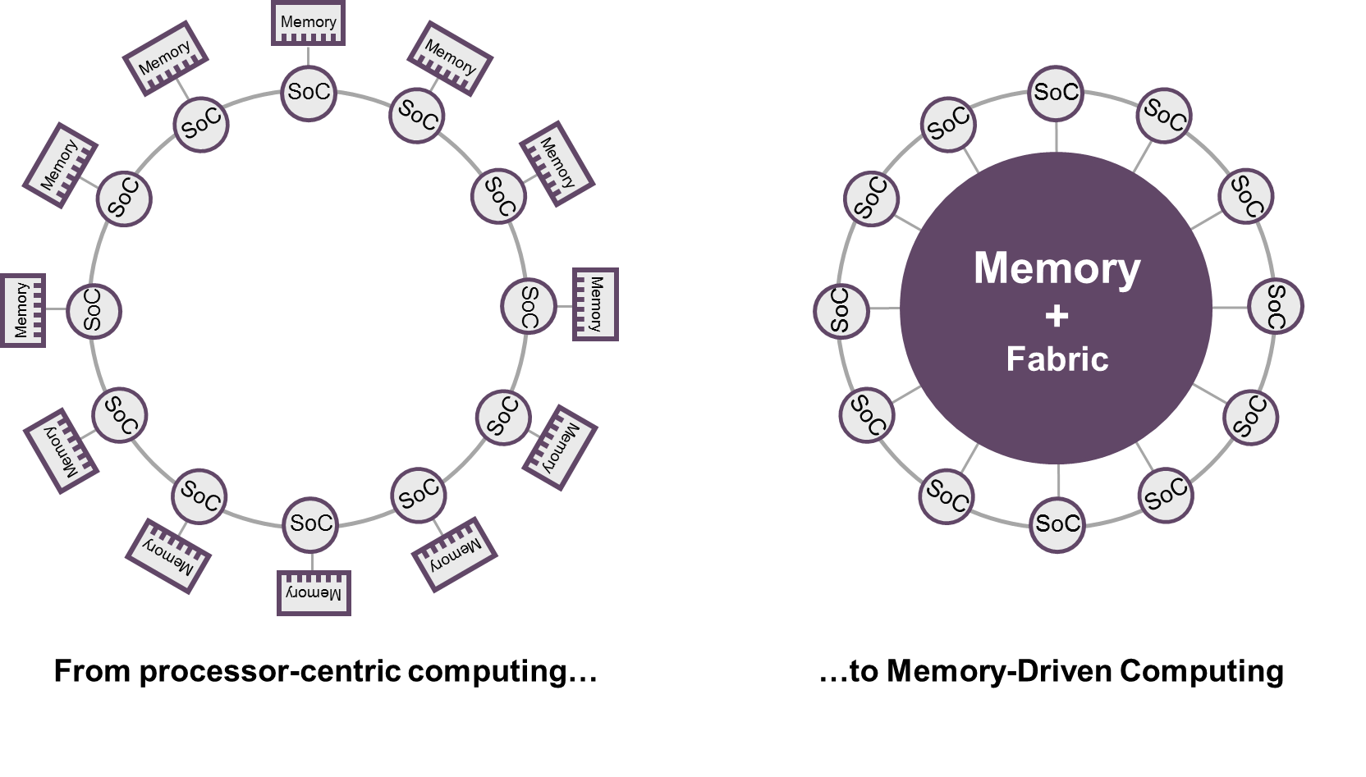
Before we wrap up: The Machine project
HPE is investing integrating non-volatile memory in servers (e.g., NVDIMMs)
The Machine: rethinking the server architecture, shared but non cache coherent memory.

Slide 107
Software artifacts
Atlas: https://github.com/HewlettPackard/Atlas
Mnemosyne: https://research.cs.wisc.edu/sonar/projects/mnemosyne/resources.html
HPE The Machine software: http://www.labs.hpe.com/research/themachine/TheMachineDistribution/
  New nvm-aware database
  Atlas compiler and runtime
  Emulators

Slide 108
Discussion and Q/A

Slide 109
Any thoughts on these?
Are the programming models we discussed the right approach for programming non-volatile memory?
  Other alternatives: Suspend/resume, checkpointing?
How do we incrementally introduce persistent memory into existing applications?
What could be new applications for persistent memory?
  Intermittent computing?
How do you debug a persistent memory application?
  persistent bugs?
  deterministic bugs?

Slide 110
Any thoughts on these?
How will we share data between users and apps? Will we still need to serialize data into a data exchange format?
How should we handle memory exceptions? If a disk write fails you check the return value, what is the semantics for handling memory write failures?
- Is security a major concern and barrier to adoption?
Is high durability and availability a prerequisite for adoption?

Slide 111
Thank you!
Any feedback?

